Slide 1
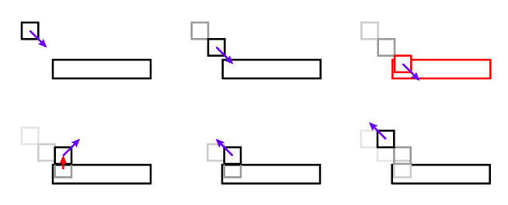
Object-Object interaction

Slide 2

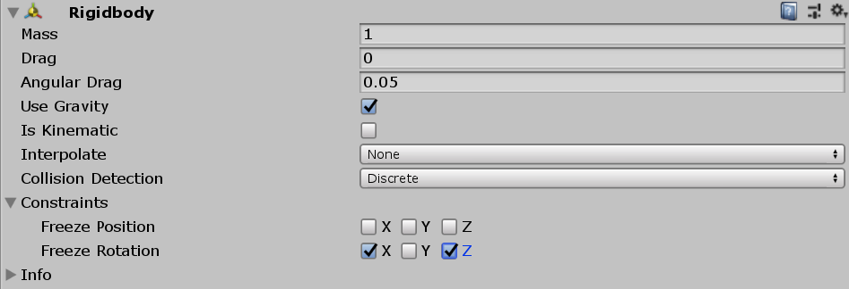
Character with Collider
First Make a new capsule GameObject and drag the Main camera so that it is a child of the capsule. Rename Capsule to something like Player.
Add a Rigidbody component to the capsule. Go to constraints and check “Freeze Rotation” for the X and Y axes. Try running with these checked and unchecked to see difference.

Slide 3
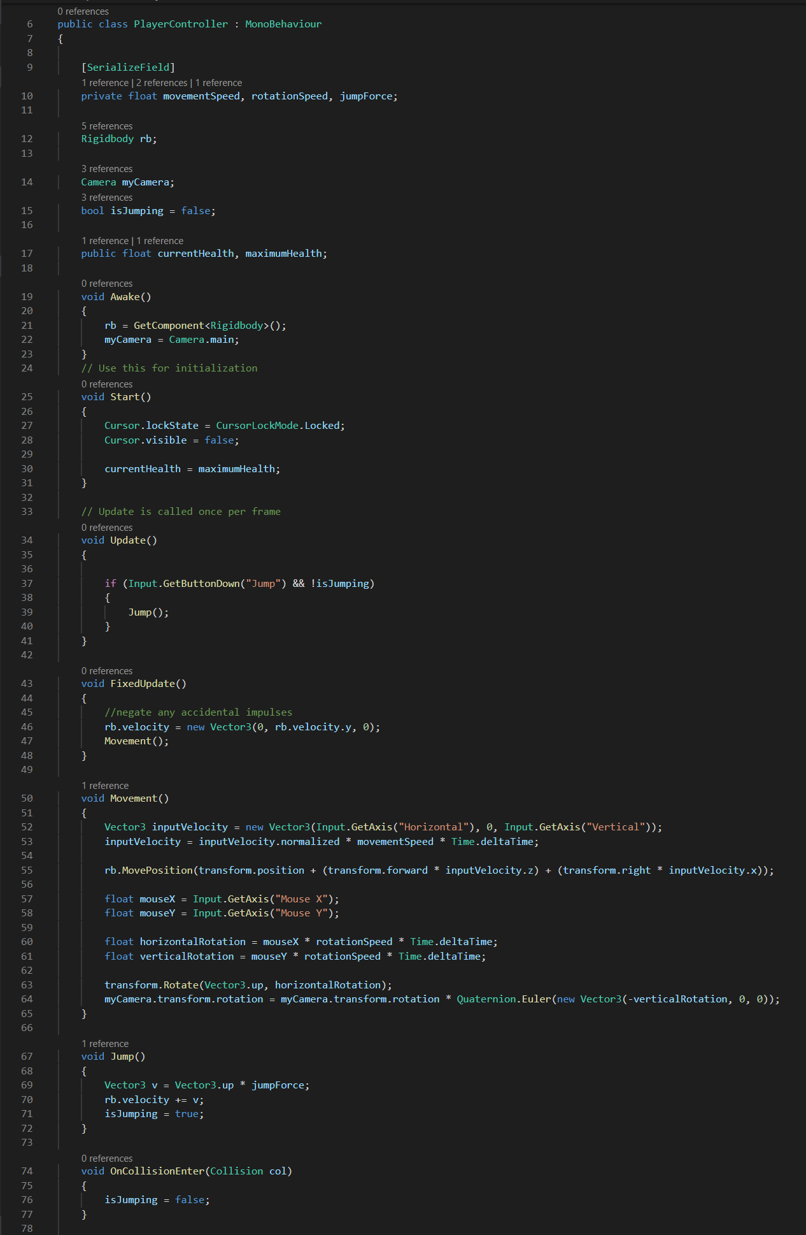
GetComponment
Get information from and pass information to our Rigidbody we need to get a reference to it.
To do this we use the GetComponent<TYPE>() method.
This is equivalent to gameObject.GetComponent<>()
We will se later in this lesson that we can get components on other GameObjects.
We do this in awake or start as it’s quite a slow method and we don’t want it happening every frame, just once at the start to get a reference.
Having a Rigidbody reference makes jumping easy.

Slide 4
Player movement
Inputs.GetAxis returns a number between -1 and 1.
Put the floats into a vector which represents a direction, normalise it so that it’s length is 1, multiply it by your speed modifier.
Transform has a method called Rotate() which takes 2 arguments, axis and value

Slide 5
Up/Down look
We get modify the rotation value of the transform component of the “myCamera” GameObject.
We apply a rotation as a Quaternion but we can convert to quaternion from the more intuitive Euler representation.
Euler representation is the familiar 3 axes, xyz.
Quaternion.Euler() does the conversion for us from the vector form to the quaternion form.
Here we’re rotating on the x axis by –verticalRotation because otherwise mouse forward would translate to a forward tilt.

Slide 6
Jump
Simply setting an upward velocity that will thrown a player in the air. The Rigidbody takes care of gravity for us.
Now we add a variable that can tell us if we are in the air or on the ground.
If we are in the not in the air we allow the jump method to run, else we cannot jump again.

Slide 7
Collisions
So you have a variable that checks if you have jumped but you need a way to check if you are allowed to go again
OnCollisionEnter() is your friend
This method fired every time an object hits your collider. It provides a Collision which you can then check for parameters such as it’s GameObject name or components.
This is useful for determining if a projectile hit an enemy or a wall for example.
We will use it to set isJumping to false.

Slide 8
Triggers
Triggers are like collisions but without the physical effect.
You can cause actions to happen with OnTriggerEnter() but there are additional ways of interacting such as OnTriggerExit() or OnTriggerStay().
We can use these to define behaviour that will happen when objects or objects of a certain type are inside of a specific area.

Slide 9
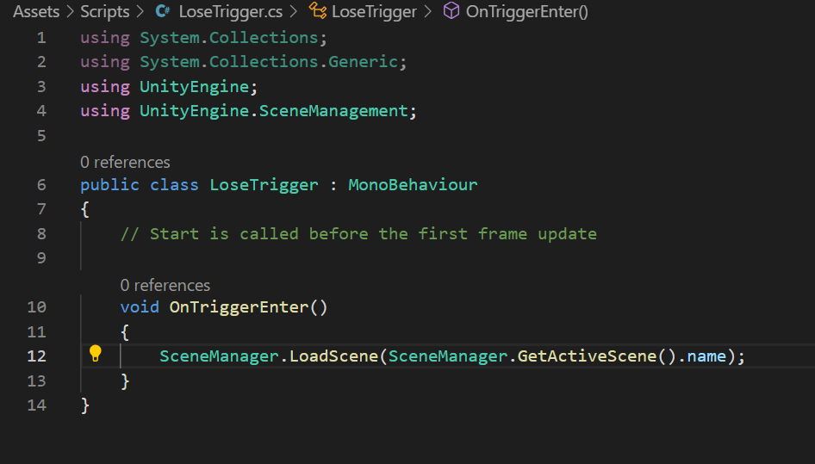
Win/Lose Triggers
A simple game might be a maze or jumping puzzle.
Each level may have an end point and some obstacles.
To send a player back to the start of the level when they have been killed we can get the current scene and load it using the SceneManagement namespace.
LoadScene takes a string so we have to add “.name” to the end of our active scene.
Easy Peasy

Slide 10
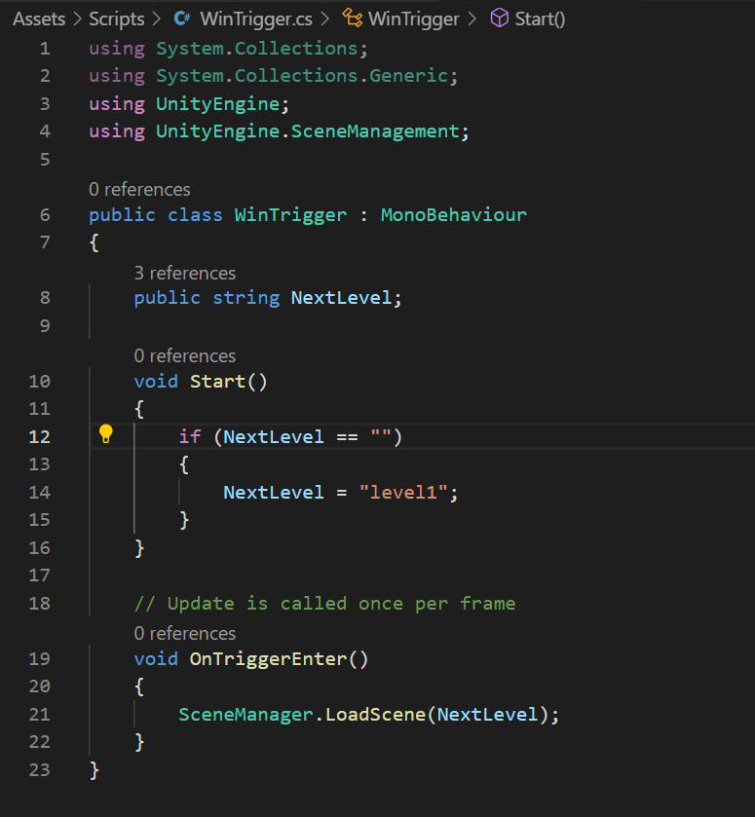
Predicting Errors
For the code to load the next level it requires manual entry of the level we intend to load.
Lets make sure that if we forget to add one, or it’s the last scene perhaps, that there is a default value. For a stirng you can do that in the declaration but this way of doing it in Start() works for any type as long as you have a default to hand that you can use.

Slide 11
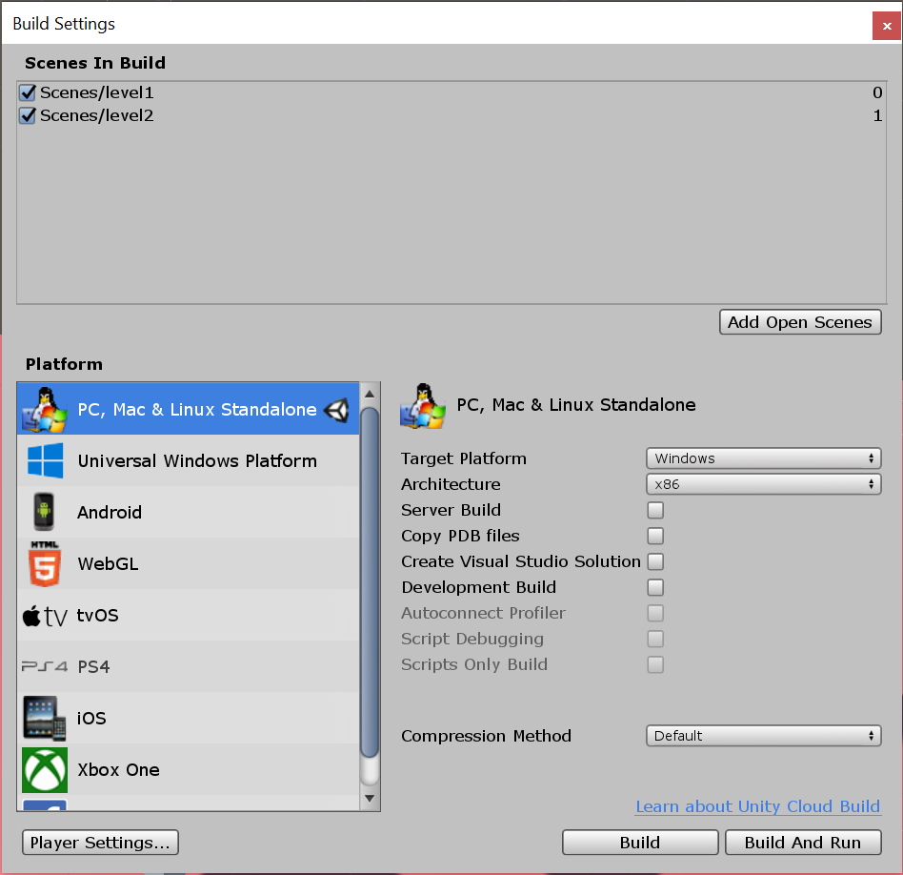
Build Settings
File -> Build Settings
Or ctrl+shift+B
You cannot load scenes in code without them being added to this list here.
Click and drag in the scenes from the Project tab

Slide 12
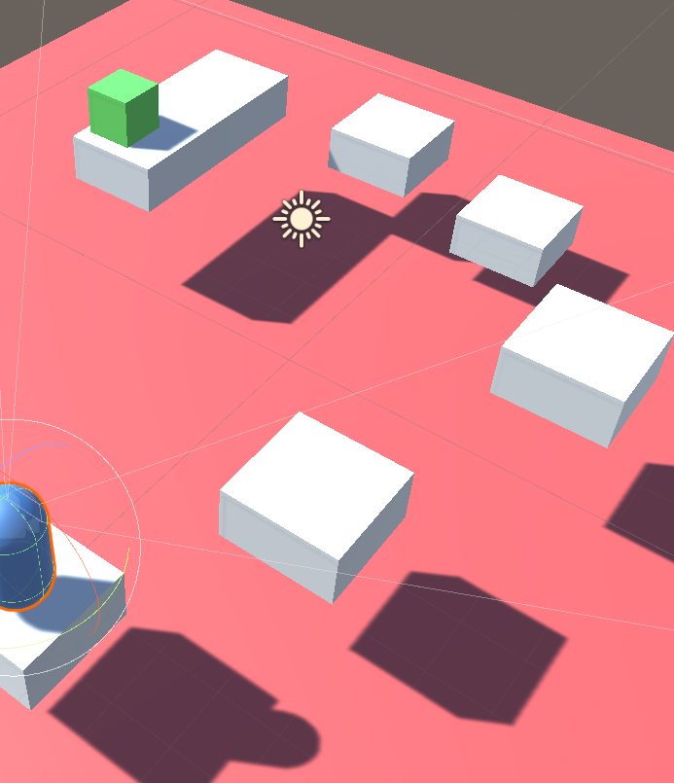
You have a game
All I’ve done is give my objects coloured materials which you know how to do.
White are just cubes renamed to platform.
Red is the lose trigger zone and green is the win zone.
The player was recoloured blue
Save prefabs and you can build your levels.
Try making an obstacle prefab that causes the player to take damage and when health equals zero, reload the scene.

Slide 13
Damage and further work
HINT: The Collision parameter in OnCollisionEnter carries a lot of information. Perhaps you could use that to selectively trigger an event.
How might we go about getting at this information?

Slide 14
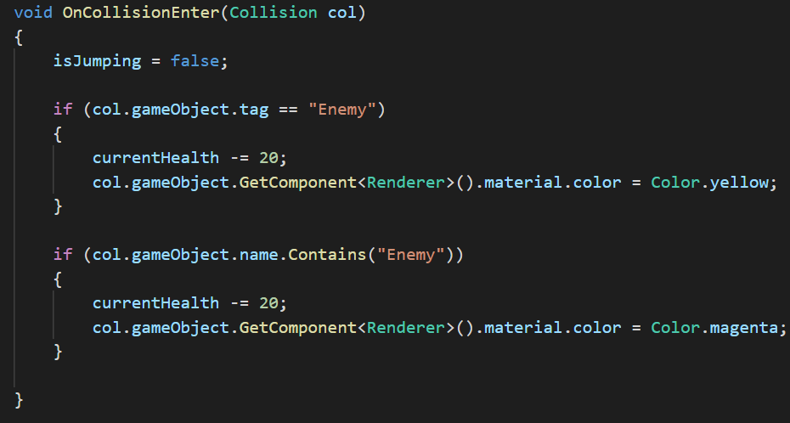
Collision Object data
Get the GameObject responsible for the collision.
From the gameobject we can get all of the components on it and modify those components or simply check them for data.
It’s incredibly powerful.

Slide 15
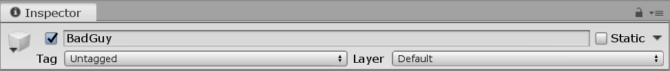
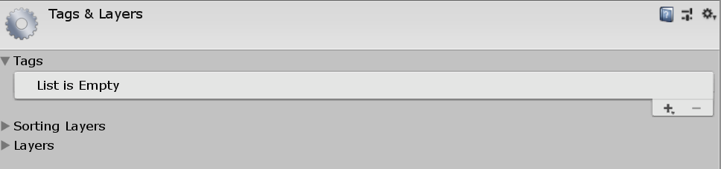
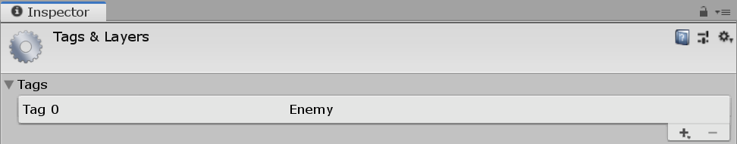
Tags
Tags can be used to describe a class of object that can then be interacted with or according to some rules.
Click on the dropdown and add a new custom tag which we’ll use to make the last slide’s code work.

Slide 16
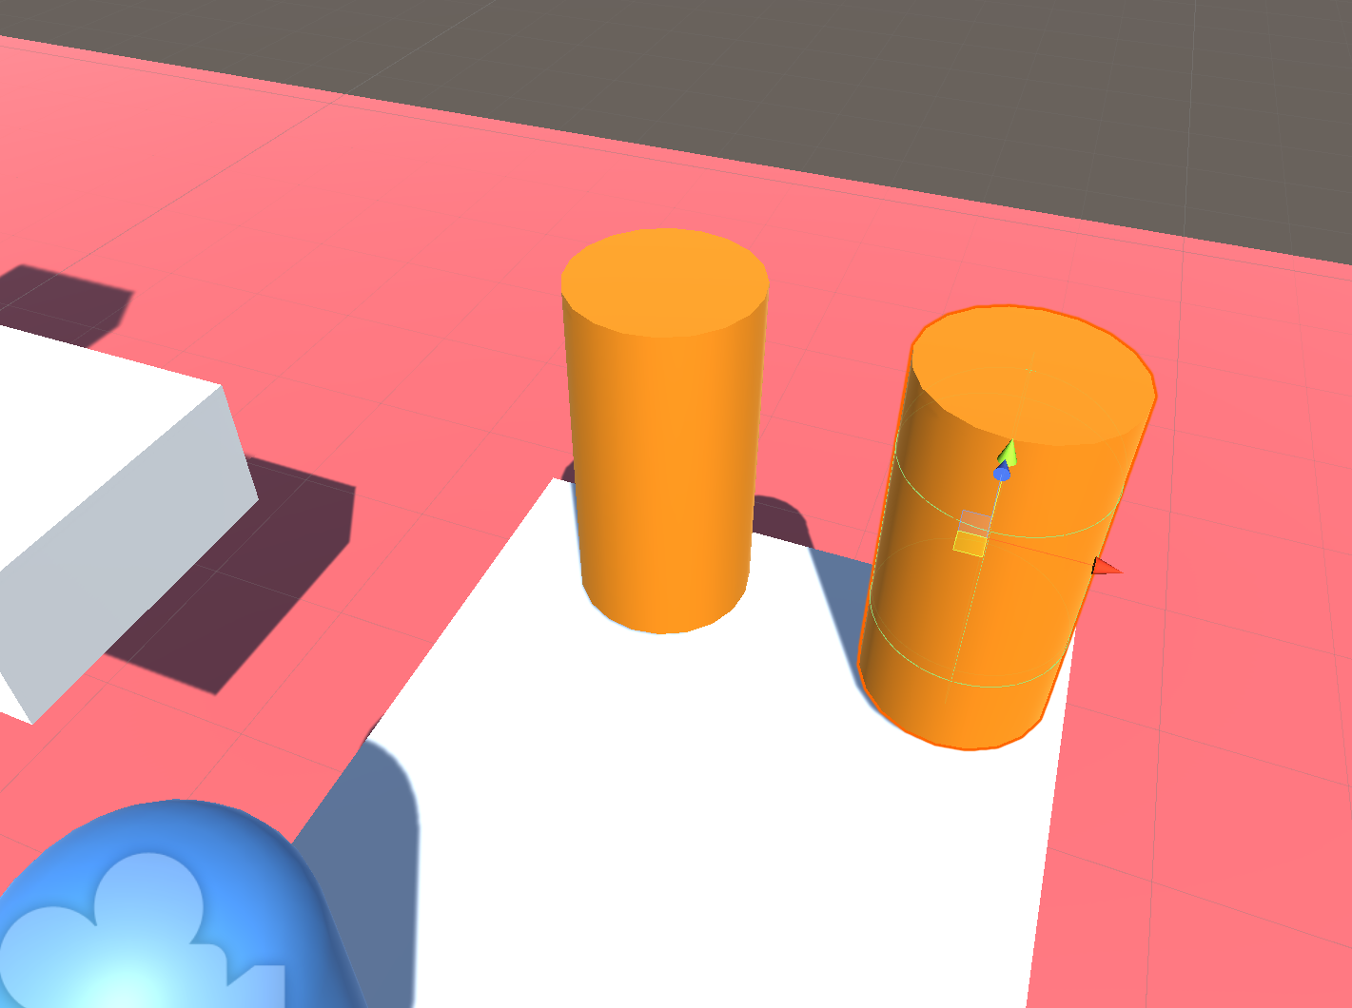
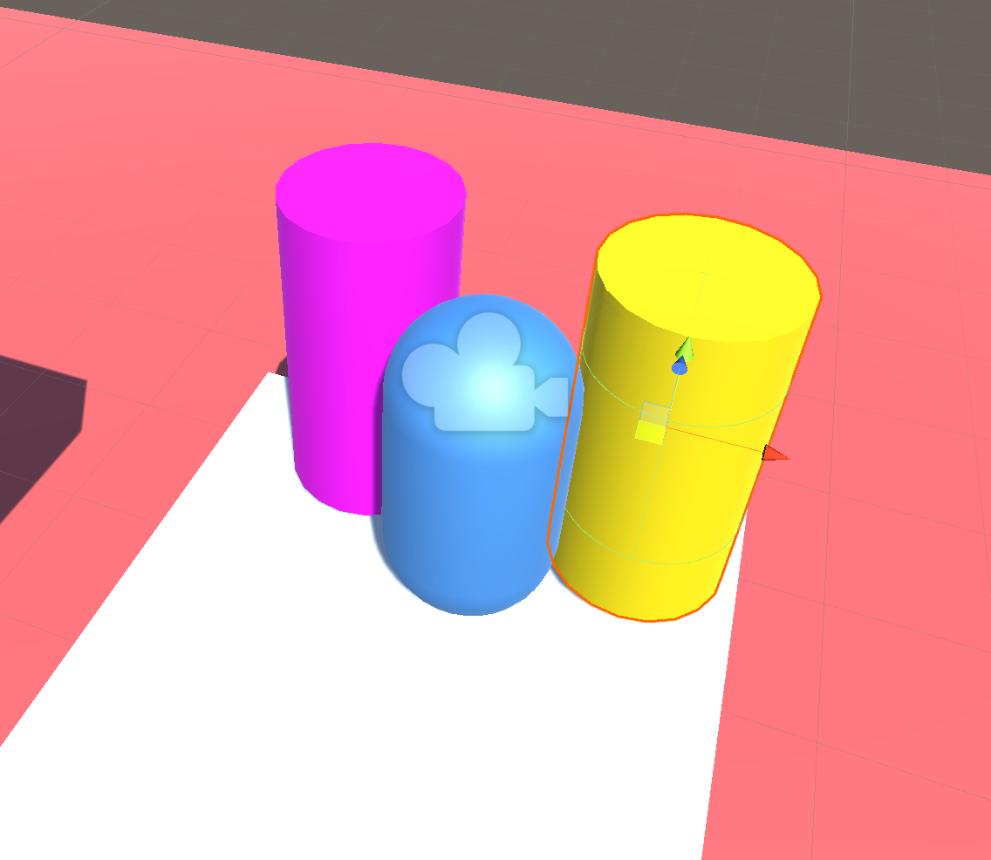
Result

Slide 17
Extra
The following slides are unlikely to be completed in the lab so I have tried to be as clear as thorough as possible with them so you may finish them later. They just build on the core lesson.

Slide 18
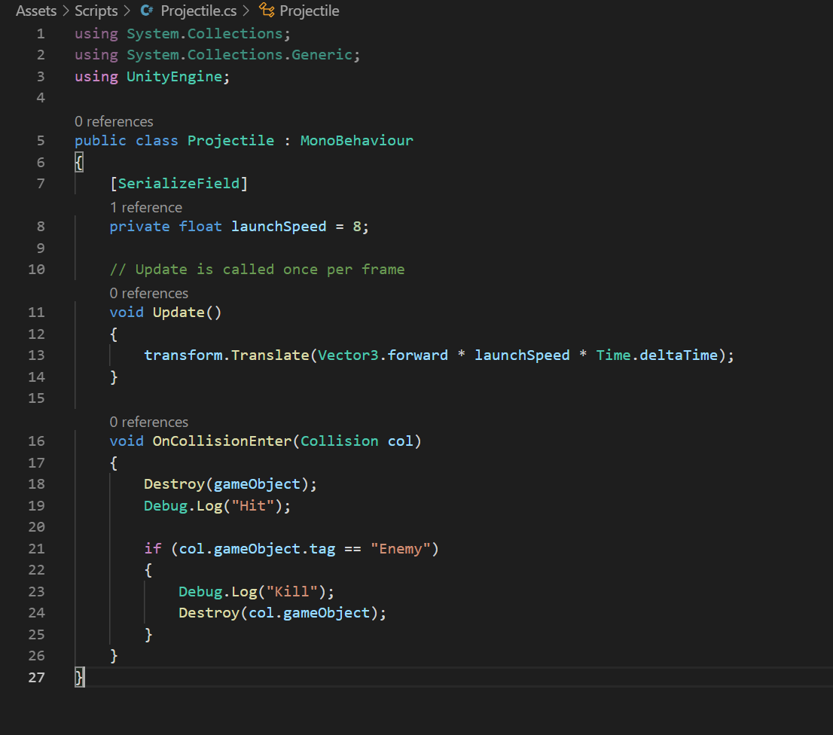
Projectiles
Really simply you’re making a small sphere or cube with a script that makes it go forward attached. This is your projectile prefab.
Then we simply spawn it.
Make it interact with the world via it’s collider.
Attach this script to your small sphere prefab.

Slide 19
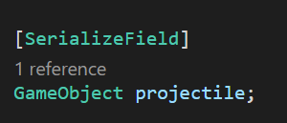
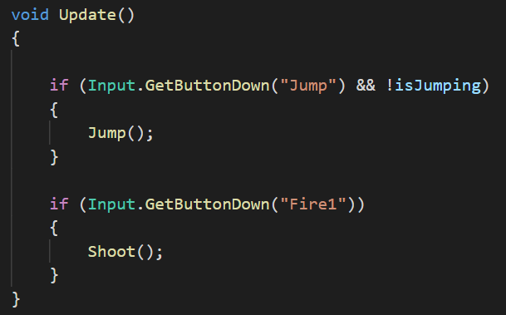
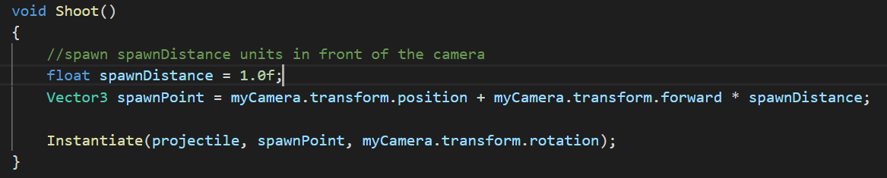
Firing
Make a GameObject variable so you can drag in the projectile prefab.
We use the Input class we learned about last week to detect the Fire1 button which is left click.
Instantiate the prefab in front of the camera.

Slide 20
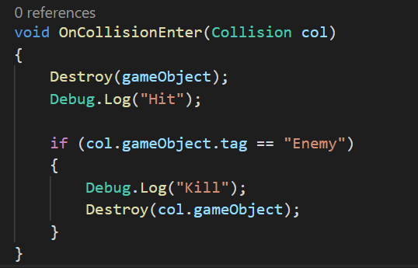
Hitting things
The collision method in the bullet script simply deletes the projectile with Destroy() if it hits anything.
If it hits something tagged enemy that object is also destroyed.
Try adding a countdown timer to your bullet so that it is destroyed after a number of seconds in the event it doesn’t hit anything. Refer to last week if necessary.

Slide 21
Contacts
Daniel “Dan” Korsah : 40214314@live.napier.ac.uk
Krzysztof “Kris” Czerwinski : 40283208@live.napier.ac.uk
Complaints to Thomas “Tom” Methven : T.Methven@napier.ac.uk

